Slide 1
Prof. Sead Muftic
Lecture 4:
Message Confidentiality and Message Integrity
Notes:
This presentation contains some slides about data security

Slide 2
Lecture 4 :
Message Confidentiality and Integrity
Subjects / Topics :
1. Basic principles of message protection
2. Message confidentiality
3. Message integrity

Slide 3
Lecture 4 :
Message Confidentiality and Integrity
Subjects / Topics :
1. Basic principles of message protection
2. Message confidentiality
3. Message integrity

Slide 4

Message Confidentiality
Some confidential
text (message)
in clear (readable)
form
Network Aspects :
* selection of algorithms
* format of messages
* message filtering

Slide 5
Significant Aspects




Aspects :
1. Algorithms: 3DES, 3DES-CBC, IDEA, ...
2. Mode, padding
3. Filtering of cryptograms
4. Integrity of cryptograms
5. Exchange of keys
Notes:
This presentation contains some slides about data security

Slide 6
Algorithms – Defaults




Solutions (standards) :
* algorithm: 3DES, AES
* mode: CBC, padding: Fx, …, Fx
* filtering of cryptograms: base64
* integrity of cryptograms: MD2
* exchange of keys: KE protocols
Notes:
This presentation contains some slides about data security

Slide 7

Algorithms – Negotiations
Negotiation protocol
A
B
Alg-1
Alg-2

Slide 8
Algorithms – OIDs
RC2 – CBC :
RC2-CBC OBJECT IDENTIFIER ::=
{iso(1) member-body(2) US(840) rsadsi(113549) encryptionAlgorithm(3) 2}
1 2 840 113549 3 2

Slide 9
Algorithms – Coding
  ENCRYPTED {ToBeEnciphered} ::= HASHED {ToBeHashed} ::=
  BIT STRING (CONSTRAINED BY { OCTET STRING (CONSTRAINED BY {
  -- must be the result of -- must be the result of
  -- applying an encipherment -- applying a hashing
  -- procedure to the BER-encoded -- procedure to the DER-encoded
  -- octects of the value of -- -- octetcs of the value --
  ToBeEnciphered }) ToBeHashed })
  SIGNATURE {OfSignature} ::=
  SEQUENCE {
  AlgorithmIdentifier,
  ENCRYPTED {
  HASHED {OfSignature}}}

Slide 10
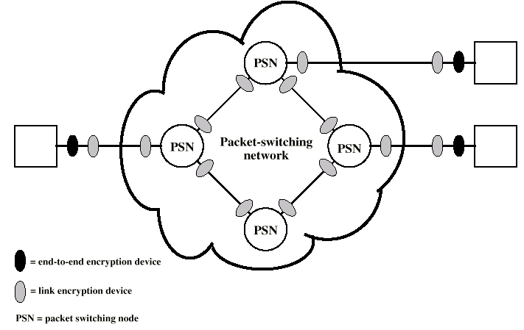
Network Topology

Slide 11
Lecture 4 :
Message Confidentiality and Integrity
Subjects / Topics :
1. Basic principles of message protection
2. Message confidentiality
3. Message integrity

Slide 12
Message Confidentiality – Encryption
Message
8
8
8
8
IV
K
K
K
K
DES
DES
DES
DES
8
8
8
8
Encrypted message
Notes:
4
This presentation contains some slides about data security

Slide 13
Message Confidentiality – Ciphers
Symmetric:
DES
AES
3DES
Blowfish / Twofish
IDEA
RC2
RC4
etc...
Asymmetric:
RSA
Elliptic Curve
ElGamal

Slide 14
Message Confidentiality – Padding
Input message
8
8
8
5
IV
K
K
K
K
DES
DES
DES
DES
8
8
8
8
Output message
Notes:
This presentation contains some slides about data security

Slide 15
Block Cipher Modes – Electronic Codebook (ECB)
Message
8
8
8
8
K
K
K
K
DES
DES
DES
DES
8
8
8
8
Encrypted message

Slide 16
Block Cipher Modes – Cipher Block Chaining (CBC)
Message
8
8
8
8
IV
K
K
K
K
DES
DES
DES
DES
8
8
8
8
Encrypted message

Slide 17
Block Cipher Modes – Cipher Feedback (CFB)
Message
8
8
8
8
IV
DES
DES
DES
DES
K
K
K
K
8
8
8
8
Encrypted message

Slide 18
Block Cipher Modes – Counter (CTR)
Message
8
8
8
8
nonce + counter
nonce + counter
nonce + counter
nonce + counter
DES
DES
DES
DES
K
K
K
K
8
8
8
8
Encrypted message

Slide 19
Message Confidentiality – Important Parameters
Key
Algorithm
Padding Mode
Cipher Mode
IV
Nonce + Counter Initial Value

Slide 20
Lecture 4 :
Message Confidentiality and Integrity
Subjects / Topics :
1. Basic principles of message protection
2. Message confidentiality
3. Message integrity

Slide 21


Destruction of Cryptograms
E n c r y p t i o n
Some confidential
text (message)
in clear (readable)
form






D e c r y p t i o n

Slide 22
General Data Integrity
Some confidential
text (message)
in clear (readable)
form
MAC
1101 0011 1010 1001

Slide 23
Integrity of Cryptograms




MAC
1101 0011 1010 1001

Slide 24
Hashing Algorithms
Message
8
8
8
8
IV
K
K
K
K
DES
DES
DES
DES
8
8
8
8
MAC
Notes:
5
This presentation contains some slides about data security

Slide 25
Verification Procedure






MAC
MAC
MAC
A
B

Slide 26
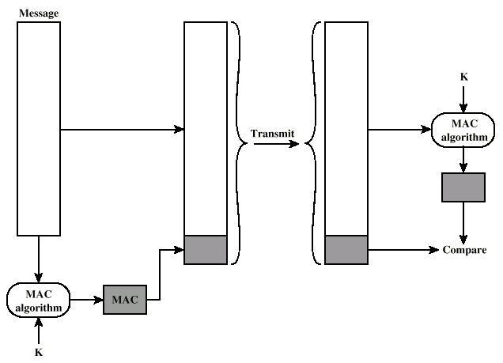
Message Authentication based on MAC

Slide 27
Modification of Message + Hash
Some confidential

in clear (readable)
form
MAC
1101 0011 1010 1001

Slide 28

Prevention
Some confidential

in clear (readable)
form
MAC
1101 0011 1010 1001

Slide 29
Encryption of MAC
Some confidential
text (message)
in clear (readable)
form
Some confidential
text (message)
in clear (readable)
form
MAC
MAC
MAC
A
B

Slide 30
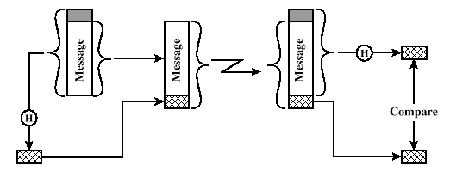
Encryption of MAC – using Shared Secret

Slide 31
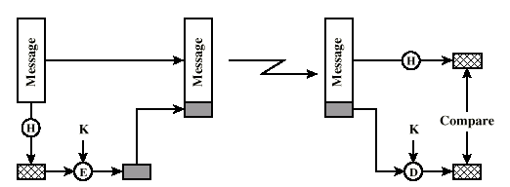
Encryption of MAC – using Secret Key

Slide 32
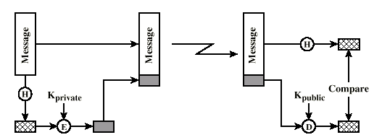
Encryption of MAC – using Private Key

Slide 33
Lecture 4 :
Message Confidentiality and Integrity
Subjects / Topics :
1. Basic principles of message protection
2. Message confidentiality
3. Message integrity

Slide 34

Questions
?

